Slide 1
KCC Advertising Performance and Sales Analysis
By: Ayush Trivedi

Slide 2


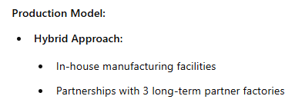
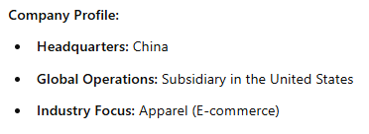

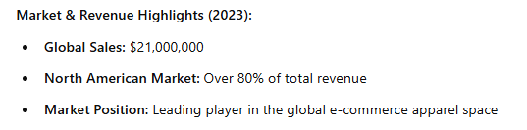
KCC Development INC Overview

Slide 3
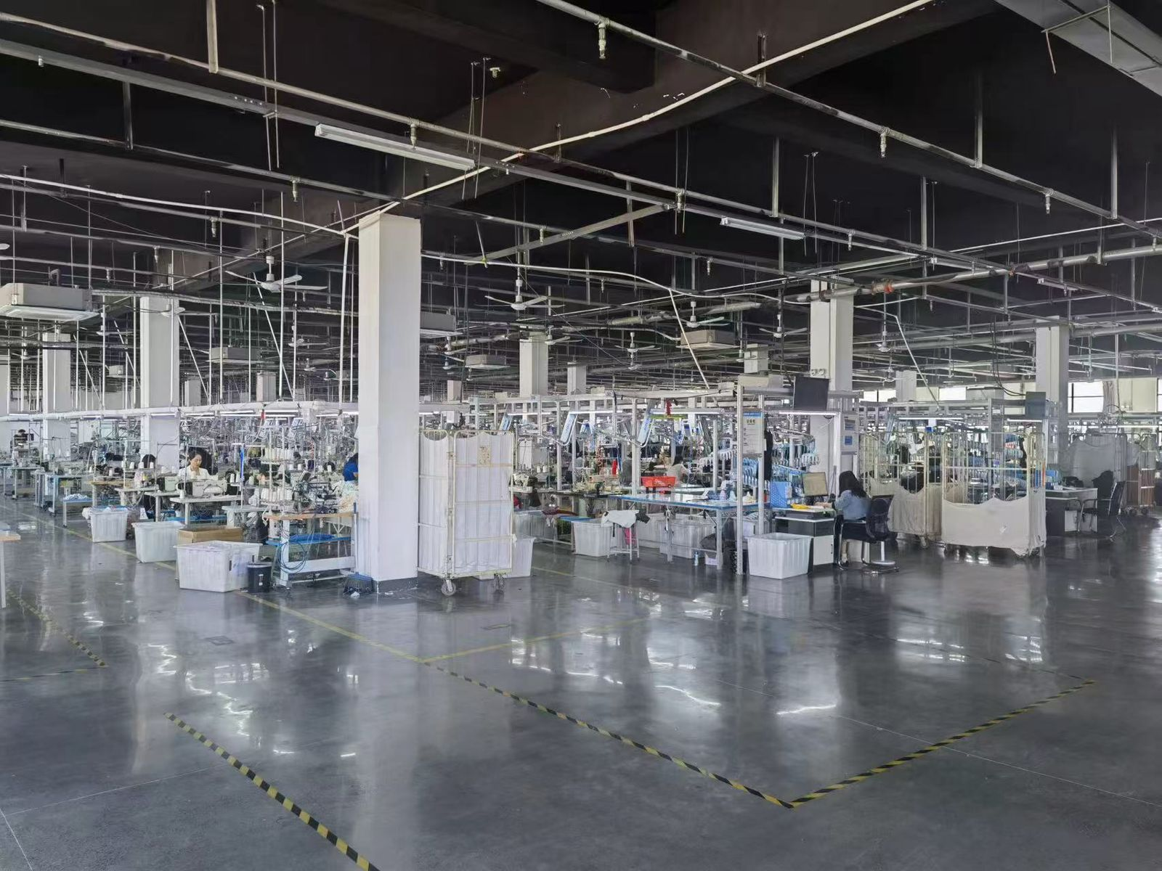
Factory Photo

Slide 4


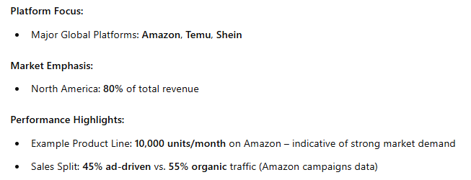




Sales Platforms and Performance:

Slide 5
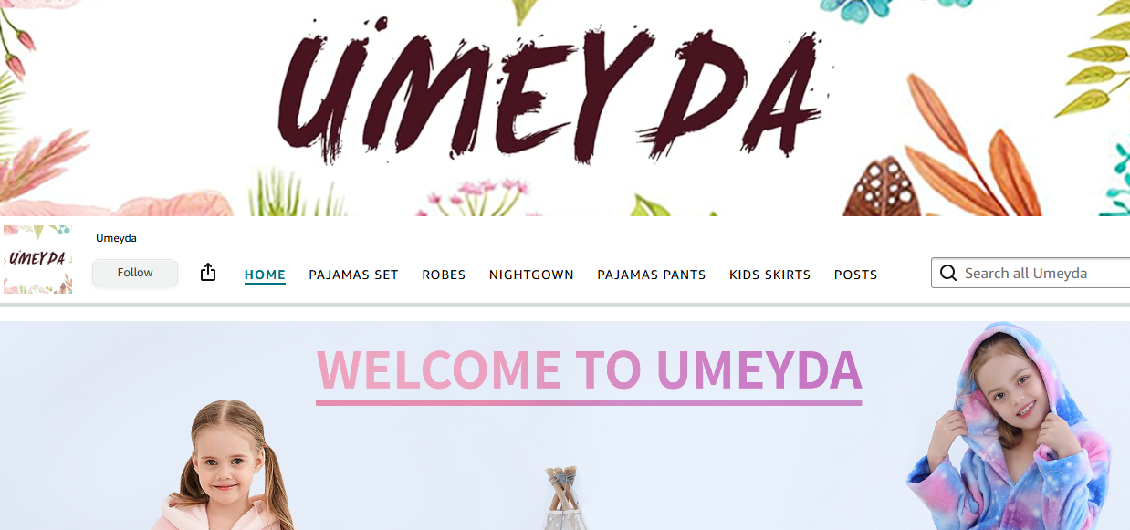
Amazon Store Insert

Slide 6


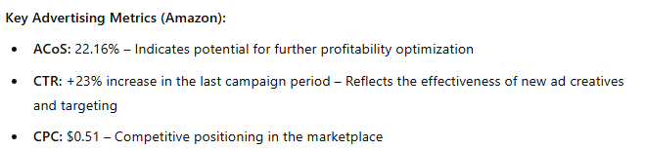
Advertising Performance & Optimization

Slide 7
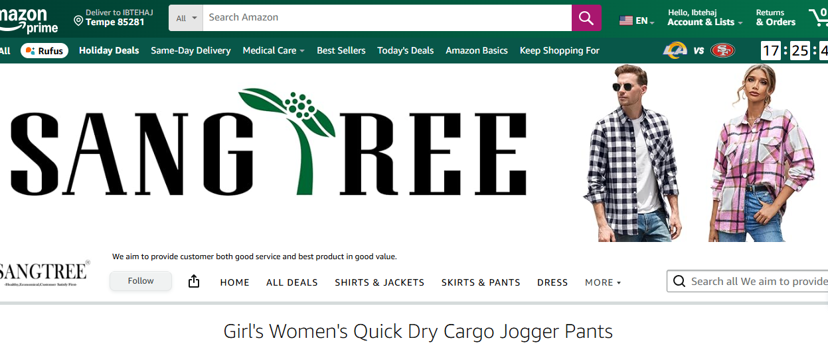
Amazon Store Insert

Slide 8
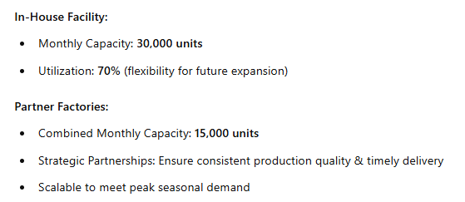


Production Capacity & Scalability

Slide 9
Optimization Questions to Answer
Which Products from the product lines to produce and which products to spend Ad money on?

Slide 10

Boiler Plate for Optimization
Inputs
Decisions
Optimization
Constraints

Slide 11
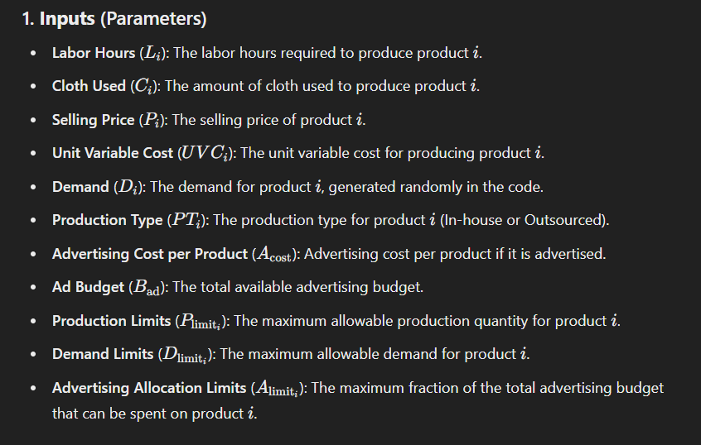

Input Parameters

Slide 12
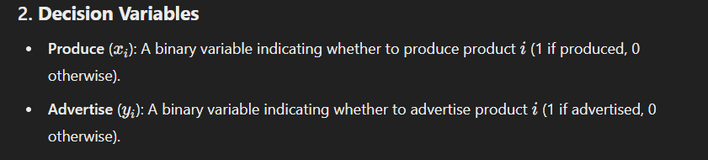

Decision Variables

Slide 13

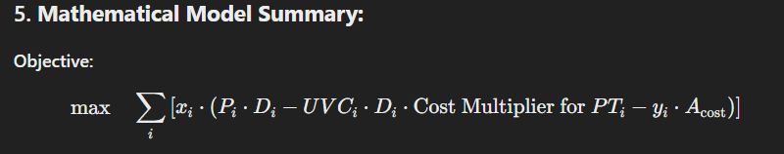
Optimization Function

Slide 14
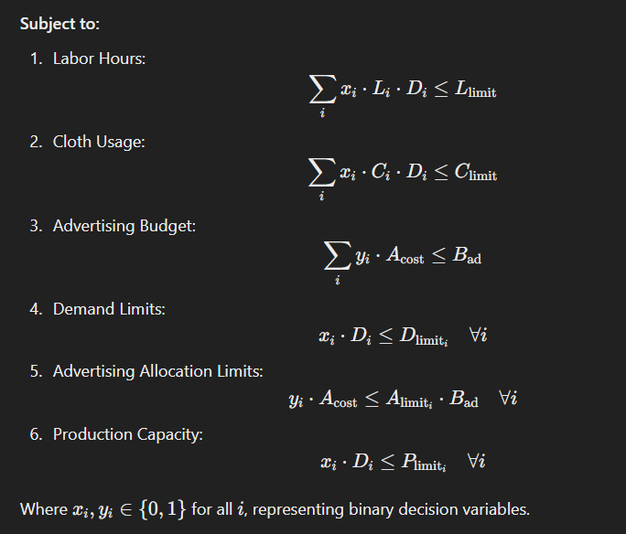

Constraints

Slide 15
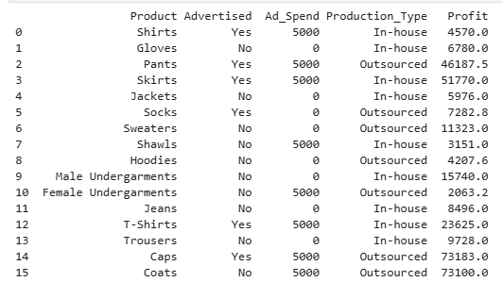
Optimal Solutions:

Slide 16



Future Considerations for the Model
Dynamic Advertising Impact: Model advertising's effect on demand using a multiplier for realistic profitability.
Incorporate Fixed Costs: Account for fixed production costs to better assess product-level profitability.
Flexible Resource Allocation: Enable outsourcing of labor and materials with cost penalties for resource flexibility.
Dynamic Pricing Strategy: Optimize selling prices dynamically to leverage demand elasticity and maximize revenue.
Seasonal and Priority Constraints: Add seasonal and priority-based weights to align production with market trends.

